Slide 1
Agile Software Development

Slide 2
Background of Agile Software Development
The process is often linear in traditional software development, with strict deadlines and a fixed scope. Agile software development, on the other hand, is a more flexible approach that allows for changes and iteration throughout the project.

Slide 3
Main concepts of Agile Software Development
Individuals and interactions over processes and tools.
Working software over comprehensive documentation.
Customer collaboration over contract negotiation.
Responding to change over following a plan.

Slide 4
The four values of Agile Software Development
Collaboration
The Agile approach relies on close cooperation between developers and customers (or other stakeholders) throughout the project. This allows for a more flexible response to changes and ensures everyone works towards the same goal.
Customer focus
In Agile projects, the customer’s needs, and wants are always the top priority. This means that features are developed in order of importance, and customer feedback is constantly incorporated into the product.

Slide 5
The four values of Agile Software Development
Adaptability
An Agile team can rapidly adapt to changes, whether external factors like market conditions or internal factors like design flaws. This flexibility is one of the key advantages of Agile over traditional methods.
Speed
Agile teams can work quickly and efficiently because they are small and focused. This allows for a shorter development cycle, meaning products can get to market faster.

Slide 6
The 12 Principles of Agile Software Development
Customer satisfaction is the primary goal.
Change is welcomed, even late in development.
Working software is delivered frequently, typically every two weeks.
Close collaboration between developers and customers is encouraged.
Projects are divided into small works called “stories.”
Daily stand-up meetings are held to track progress and identify impediments.

Slide 7
The 12 Principles of Agile Software Development
Team members self-organize to accomplish their work.
Face-to-face communication is preferred over writing documentation.
Working software is the primary measure of progress; documentation and other deliverables are secondary.
The team regularly reflects on how they are doing and adjusts accordingly.
Seek excellence continuously.
Adapt to change as a source of competitive advantage.

Slide 8
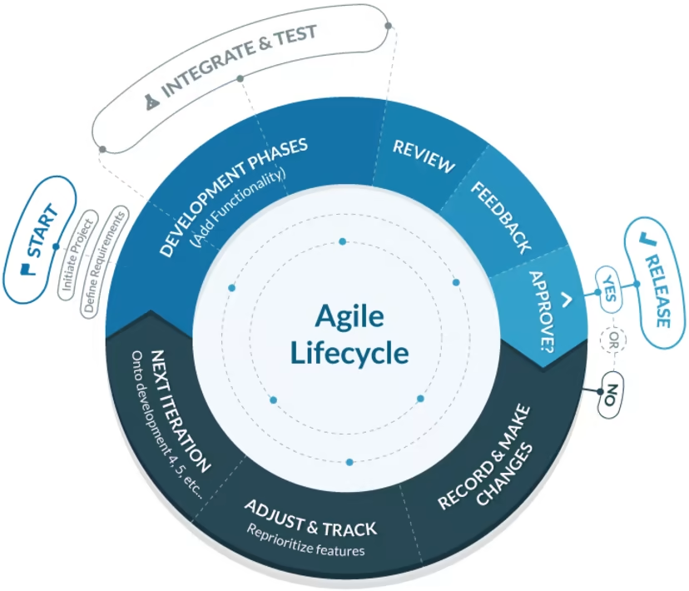
The Agile Software Development Cycle

Slide 9
The Agile Software Development Cycle-I
Start the project.
Define what the project is and what its goals are.
Create guidelines for the project’s requirements.
Develop a software function.
Integrate the function.
Test the function.

Slide 10
The Agile Software Development Cycle-II
If the test succeeds, move on to the next function and repeat steps 4-6.
If the test does not succeed, record what went wrong and implement changes until the function works.
Reflect and reprioritize based on client feedback and new challenges.
Once tested and integrated, release the function to the market.
Move on to the next function development and repeat steps 4-10 until the project is done.

Slide 11
Types of Agile Methodologies
Adaptive Software Development (ASD)
Crystal
Dynamic Systems Development Method (DSDM)
Extreme Programming (XP)
Feature-Driven Development (FDD)
Kanban (depending on how you use it)
Lean
Scrum

Slide 12
Types of Agile Methodologies
Scrum
Scrum is the most well-known type of agile methodology. It is characterized by short sprints (usually two weeks) during which specific tasks are completed.
At the end of each sprint, there is a review period where the team assesses their progress and decides what to do next. Scrum is best suited for well-defined projects with relatively simple requirements.

Slide 13
Types of Agile Methodologies
In a nutshell, Scrum requires an environment where:
Increments of valuable work are delivered in short cycles of one month or less, which are called Sprints. Ongoing feedback occurs during the Sprint, allowing for inspection and adaptation of the process and what will be delivered.
The Scrum Team has a Scrum Master, a Product Owner and Developers, who are accountable for turning the selection of the work into an Increment of value during a Sprint.
The Scrum Team and other members of their organization, business, users or customer-base known as stakeholders, inspect the results of the Sprint and adjust for the next one.

Slide 14
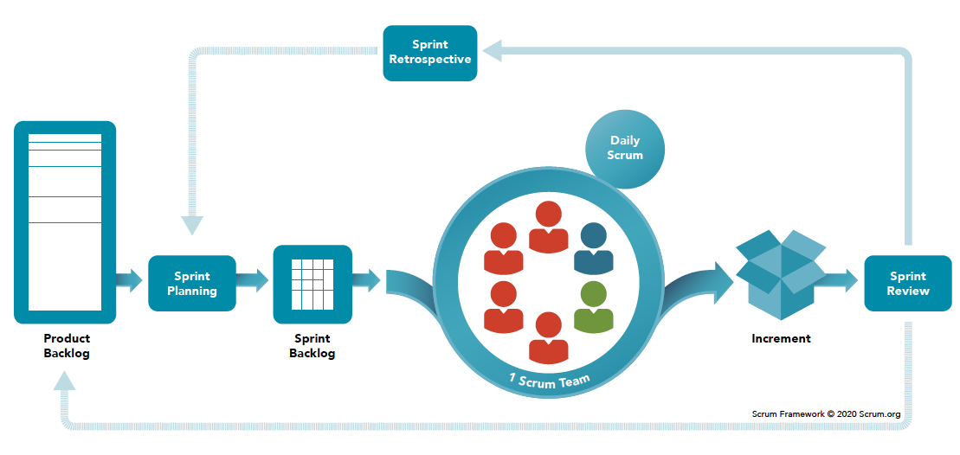
Types of Agile Methodologies
Notes:
A product backlog is a prioritized list of work for the development team that is derived from the roadmap and its requirements.
A sprint backlog is a list of work items your team plans to complete during a project sprint.
Sprint Retrospective is to plan ways to increase quality and effectiveness.

Slide 15
Types of Agile Methodologies
XP
XP is best suited for more complex projects requiring constant changes and adaptability. XP places a strong emphasis on customer satisfaction and continuous delivery. Unlike Scrum, XP has no defined sprints but an ongoing development cycle, testing, and feedback.

Slide 16
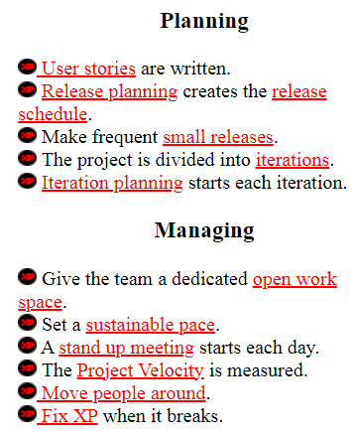
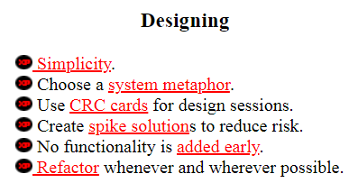
XP

Slide 17
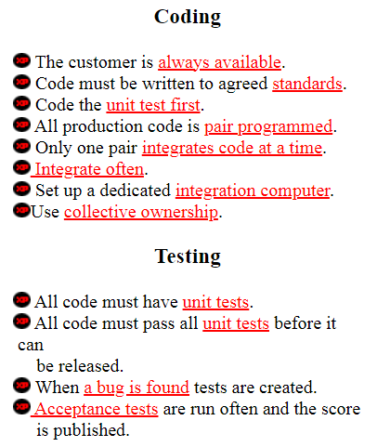
XP

Slide 18
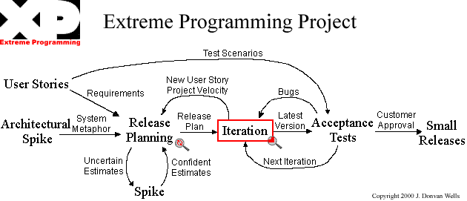
Notes:
A spike is a type of work (a small story) done by a team to gather information and determine what is required for reducing the risks and resolving particular software issues. The term “spike” relates to eXtreme Programming (XP) and means a task to research a question and resolve problems.
System metaphor stands for a simple design that has a set of certain qualities. First, a design and its structure must be understandable to new people. They should be able to start working on it without spending too much time examining specifications.

Slide 19
References
https://www.scrum.org/learning-series/what-is-scrum
http://www.extremeprogramming.org/rules.html
https://www.vates.com/what-is-agile-software-development-a-comprehensive-guide/
https://www.capterra.com/resources/the-ultimate-guide-to-agile-software-development/

